Slide 1
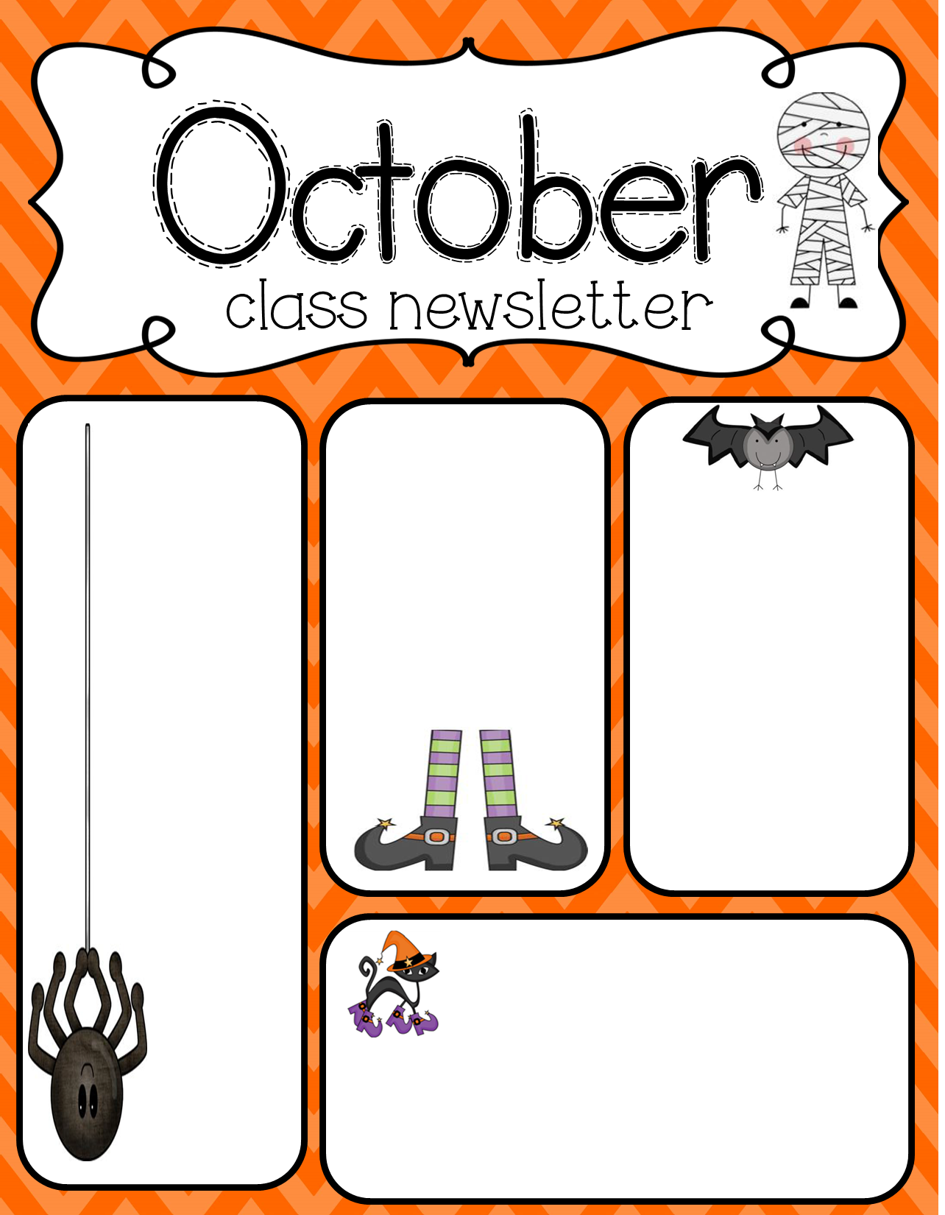
Important Dates:
October 11th-
No School
October 14th-
No School
October 31st:
11:15 Dismissal
Please check blue folders every night. Continue to study sight words at home and complete nightly homework.
Please message me on remind with any questions!
Thank you!
-Mrs. Padilla
Lawn Manor
Halloween
Parade:
October 31st
9am
1st Math: Finding the total of two or more quantities up to 20.
2nd Math: Missing Addends
1st ELA: Recognize the sequence of letters in a word.
2nd Grade: Long & Short Vowel Sounds

